Slide 1

Credit Card Default Prediction
Analyzing bank customer dataset to find the factors which might affect credit card default and finding the most optimal machine learning model to predict the credit card default.

Slide 2
Problem Statement
One of the major problems faced by banks worldwide is that of ‘Credit Card Default’. ‘Credit Card Default’ occurs when a customer fails to pay the minimum amount due on the credit card for consecutive months.
Early identification of customers who are likely to default on their credit card payments would help the bank to take proactive measures such as offering assistance or lowering credit limit to minimize losses.

Slide 3
Problem Objective
Building an optimal predictive model that can classify customers into ‘default’ or ‘non-default’ categories.
Using historical data such as default payments, demographic factors, credit data, history of payment, and bill statements of credit card clients to train the models.
Evaluating and comparing model performance using appropriate metrics such as accuracy,precision,recall,F1-score, ROC(AUC) and confusion matrix.
Optimizing the models to achieve a balance between accurately identifying defaulters and minimizing false positives.
Interpreting the model’s results to understand the key factors influencing credit card default risk, to provide actionable insights for risk management strategies.

Slide 4
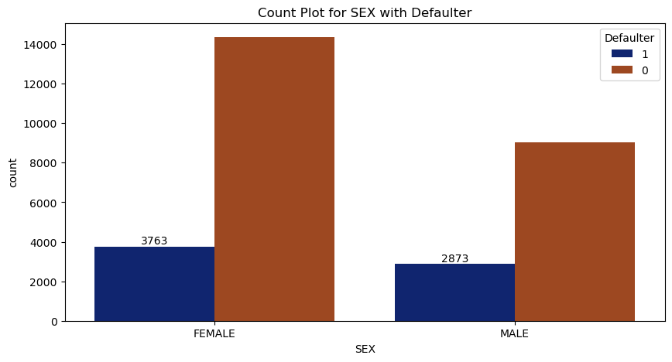
Analyzing the impact of the Categorical Variable ‘Gender’ on the likelihood of Credit Card Default.
The number of defaulters have a higher proportion of females.
.
Gender | Defaulter
Female | 3763
Male | 2873

Slide 5
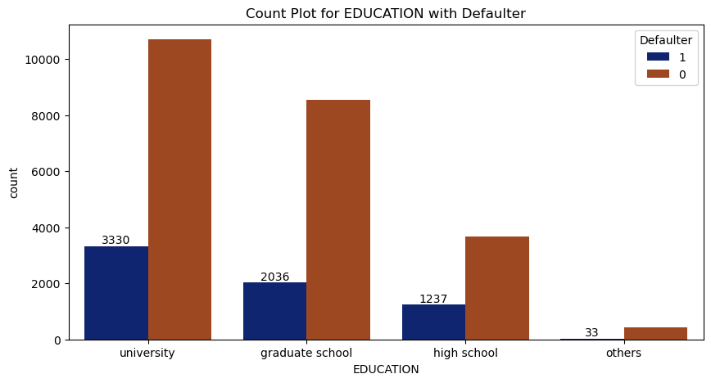
Analyzing the impact of the Categorical Variable ‘Education’ on the likelihood of Credit Card Default.
The number of defaulters have a higher proportion of educated people ( University & Graduate School).
Education | Defaulter
University | 3330
Graduate School | 2036
High School | 1237
Others | 33

Slide 6
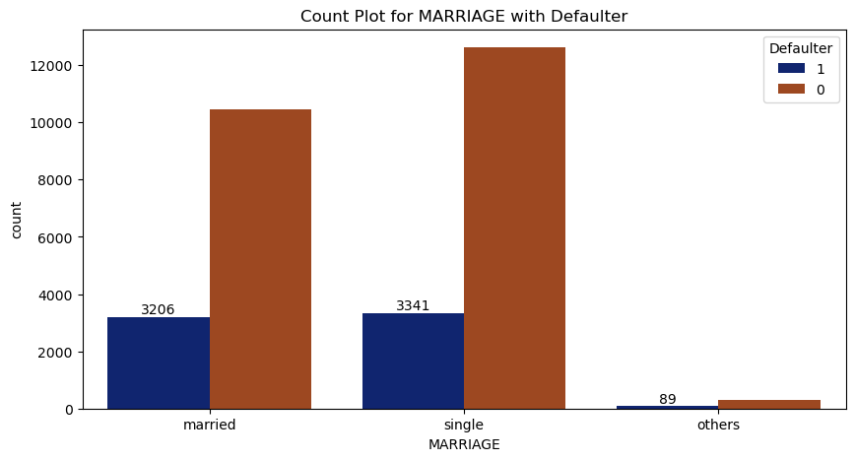
Analyzing the impact of the Categorical Variable ‘Marriage’ on the likelihood of Credit Card Default.
The number of defaulters have a higher proportion of singles.
MARITAL STATUS | Defaulter
MARRIED | 3206
SINGLE | 3341
OTHERS | 89

Slide 7
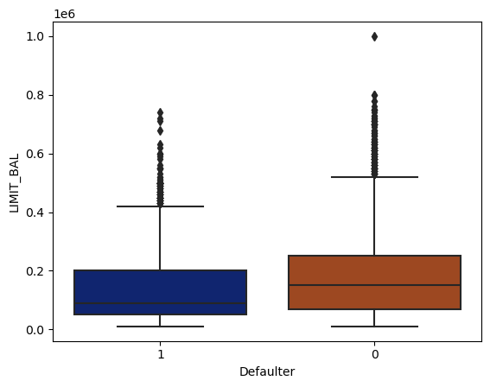
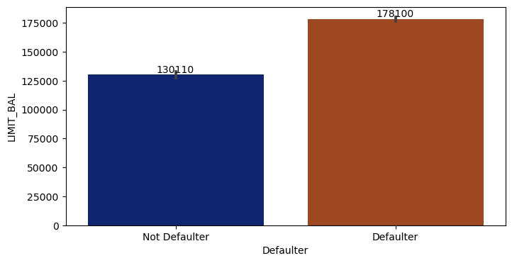
Analyzing the impact of numerical feature ‘Limit Balance’ on Credit Card Default.
Defaulters on an average have a
lower limit balance.

Slide 8
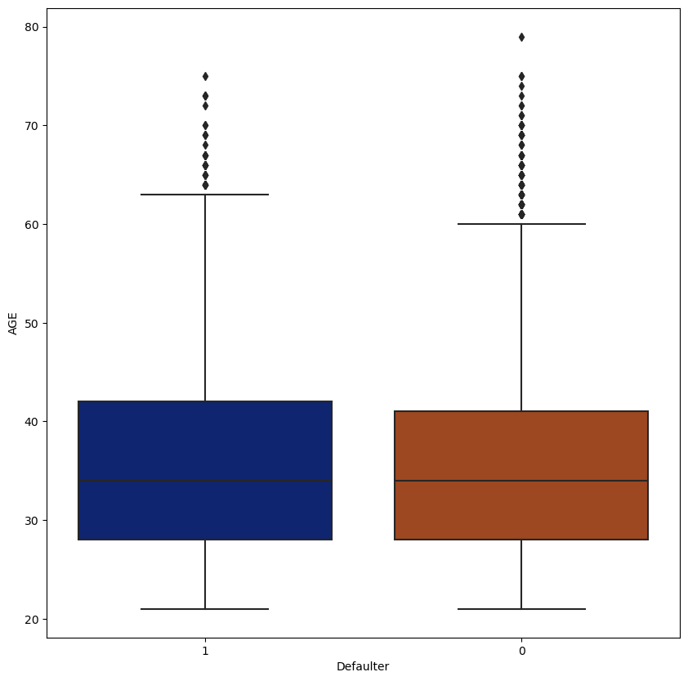
Analyzing the impact of numerical feature ‘Age’ on Credit Card Default.
We see that Age doesn’t have much impact on Credit Card Default.

Slide 9
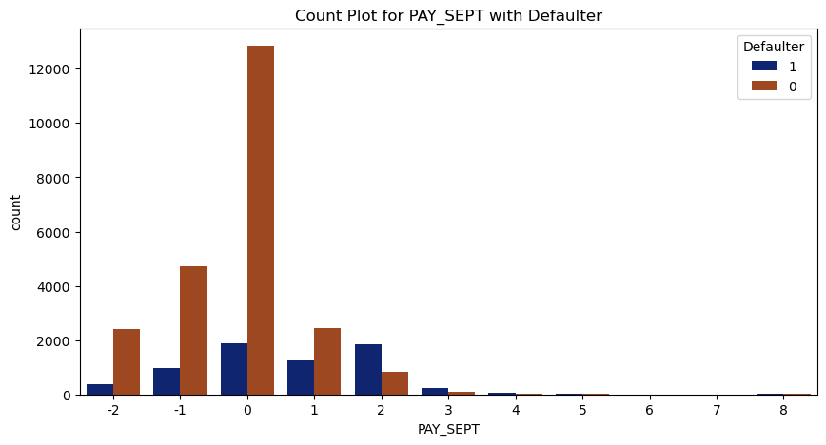
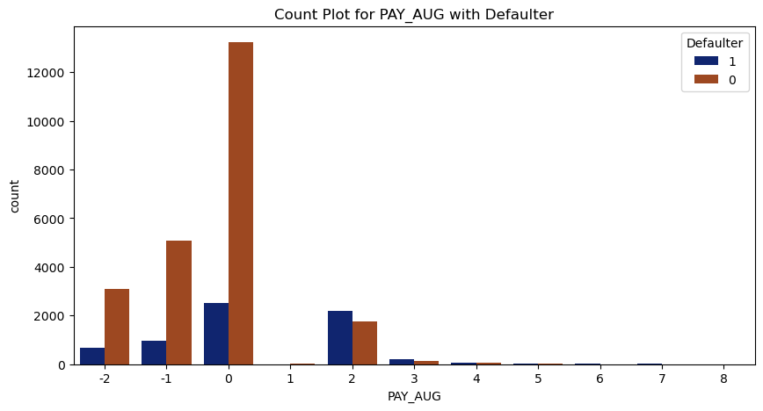
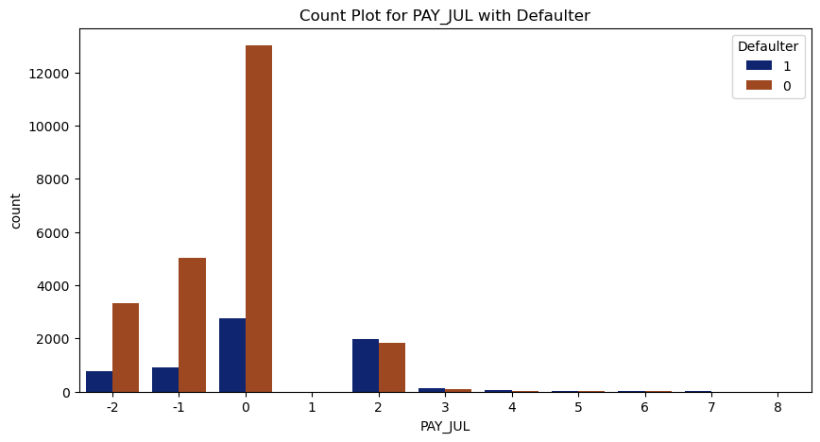
Analyzing the repayment status
Repayment Status for September.
Repayment status for August.
Repayment status for July.

Slide 10

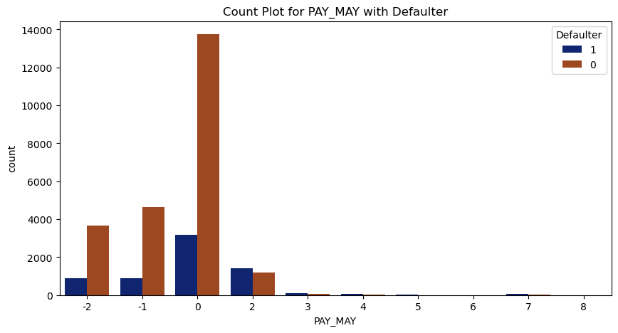

Analyzing the repayment status
Repayment Status for June.
Repayment status for May.
Repayment status for April.

Slide 11
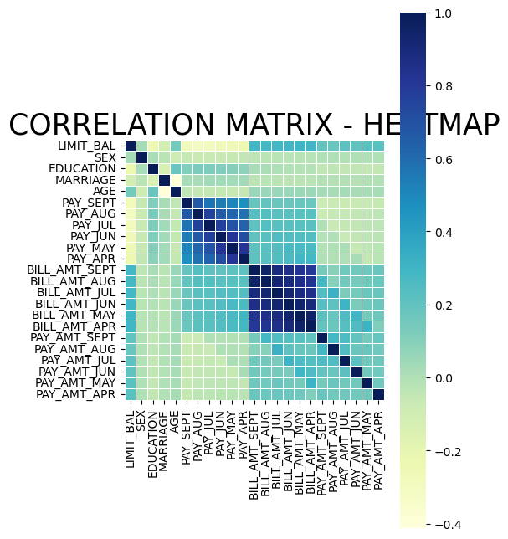
Correlation Matrix for the various features.

Slide 12
The classification models used for this analysis are: Logistic Regression, Decision Tree & Random forest classifier.
Decision Tree
Random Forest Classifier
Logistic Regression
It is a binary classification algorithm that predicts the probability of an instance belonging to a particular class.
Here, we’ve used Logistic Regression to predict whether a credit card holder will default (1) or not default (0) based on the various features of the customer dataset.
Decision trees are non-linear models that partition the feature space into regions, making decisions based on simple rules inferred from the data.
Here, we’ve used decision tree which works in a flowchart like structure to predict default based on the various features of the customer dataset.
Random forest is an ensemble learning method that constructs multiple decision trees and combines their predictions for improved accuracy and generalization.
Here, random forest can handle complex interactions between features and provide robust predictions.

Slide 13
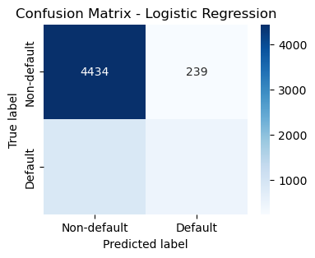
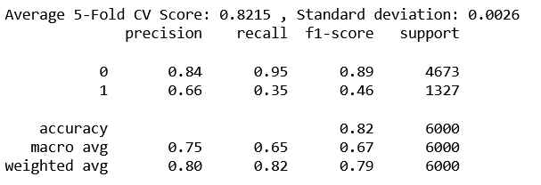
Logistic Regression
Classification Report
Confusion Matrix
863
464

Slide 14

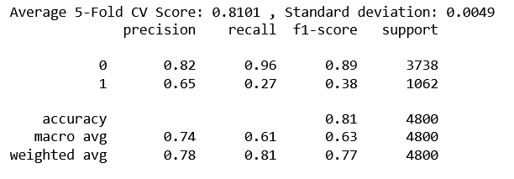
Logistic Regression ( Most Important Features)
Classification Report
Confusion Matrix
779
283

Slide 15
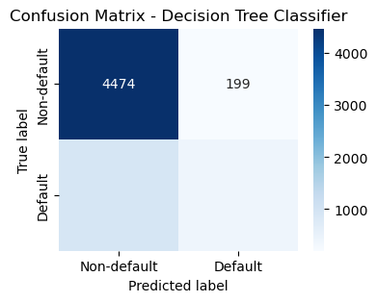
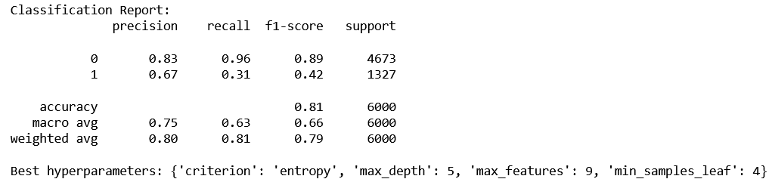
Decision Tree Classifier
Classification Report
Confusion Matrix
917
410

Slide 16
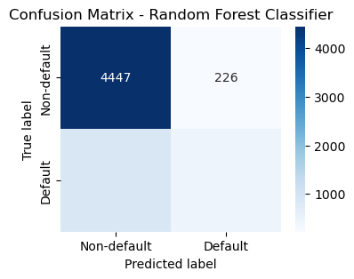
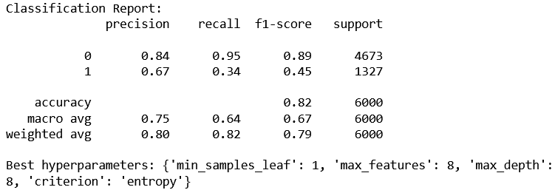
Random Forest Classifier
Classification Report
Confusion Matrix
878
449

Slide 17
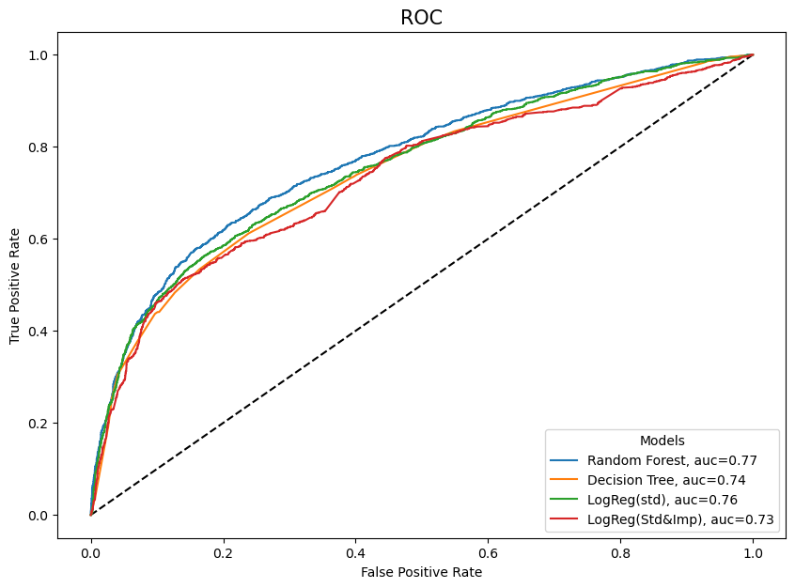
Receiver Operating Curve(ROC)
The Receiver Operating Characteristic Curve (ROC) is a plot of the true positive rate against the false positive rate. If the Area Under the Curve (AUC) is high it means the model is good at distinguishing between positive and negative class. The highest AUC is attained for Random Forest Classifier which means that there is a 77% chance that the model will be able to distinguish between default class and non-default class.

Slide 18
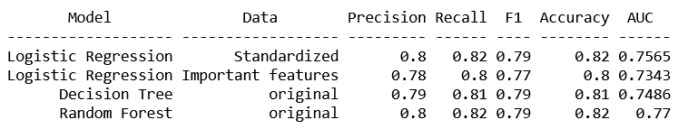
Comparison of Model Performance
F1 score is a weighted average of precision and recall and is an useful metric when there is imbalanced class distribution.
From the model comparison chart we can conclude that the Random Forest Classifier is the best model out of these in predicting credit card default.
Predicting which credit cards are likely to default will help the bank in taking corrective action beforehand to prevent the default and prevent losses.

